Slide 1
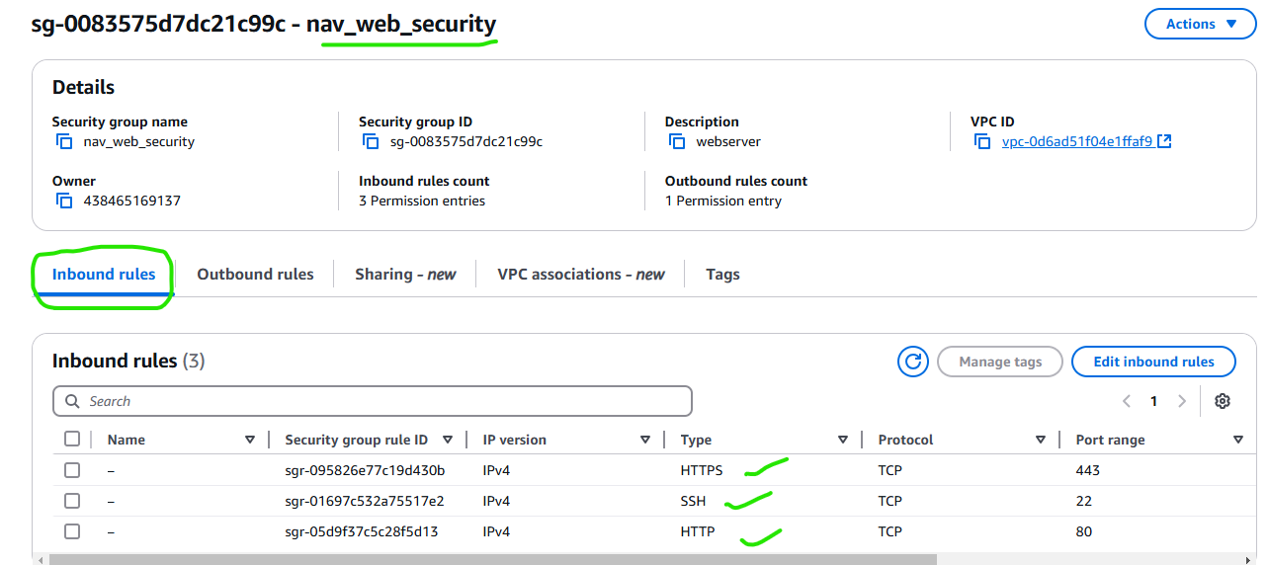
Create a Security group for both servers

Slide 2
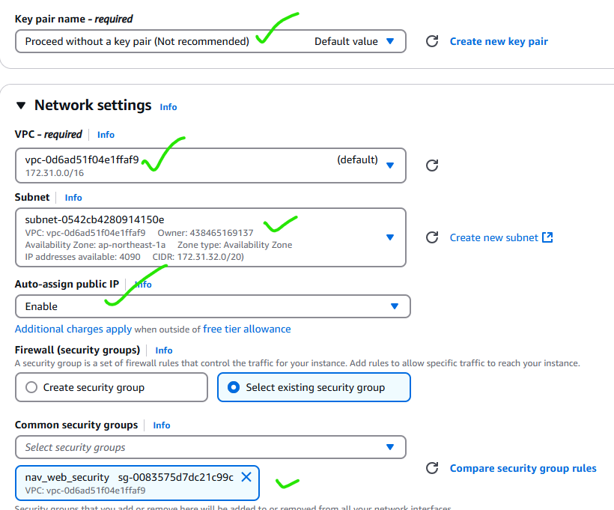
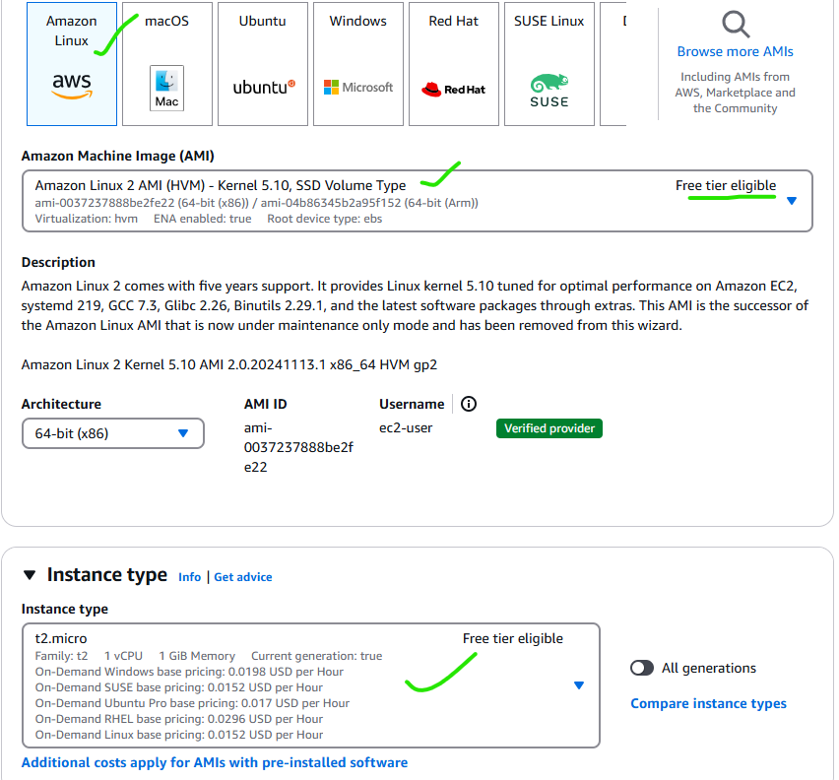
Steps to Create a EC2 web & application server

Slide 3
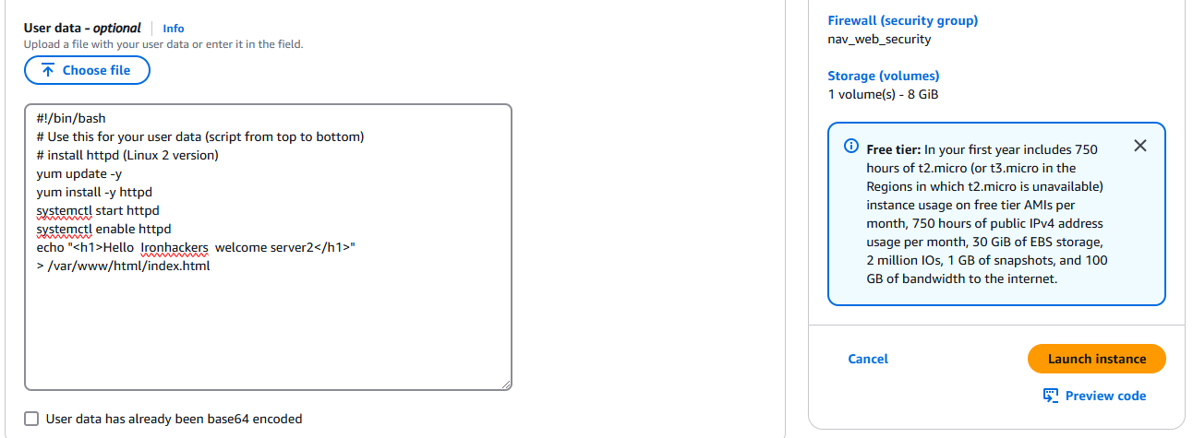
Create a EC2 web application server
#!/bin/bash
# Use this for your user data (script from top to bottom)
# install httpd (Linux 2 version)
yum update -y
yum install -y httpd
systemctl start httpd
systemctl enable httpd
echo "<h1>Hello Ironhackers welcome server2</h1>"
> /var/www/html/index.html
In advanced settings , Copy this code for application server 2

Slide 4
Steps to Create a EC2 web server
#!/bin/bash
# Use this for your user data (script from top to bottom)
# install httpd (Linux 2 version)
yum update -y
yum install -y httpd
systemctl start httpd
systemctl enable httpd
echo "<h1>Hello Ironhackers welcome server2</h1>"
> /var/www/html/index.html
In advanced settings , Copy this code for webserver1

Slide 5
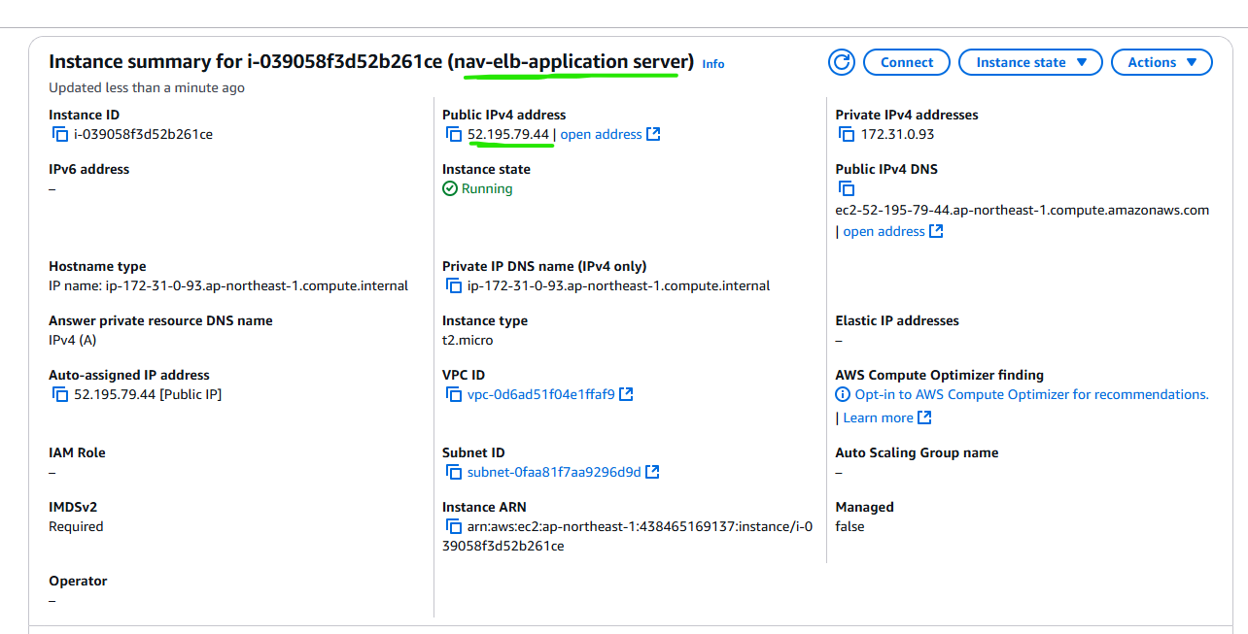
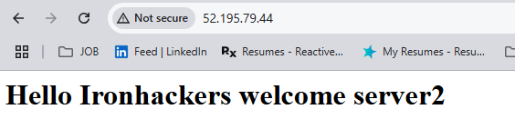
EC2 - Application server created and checked it with its public ip

Slide 6
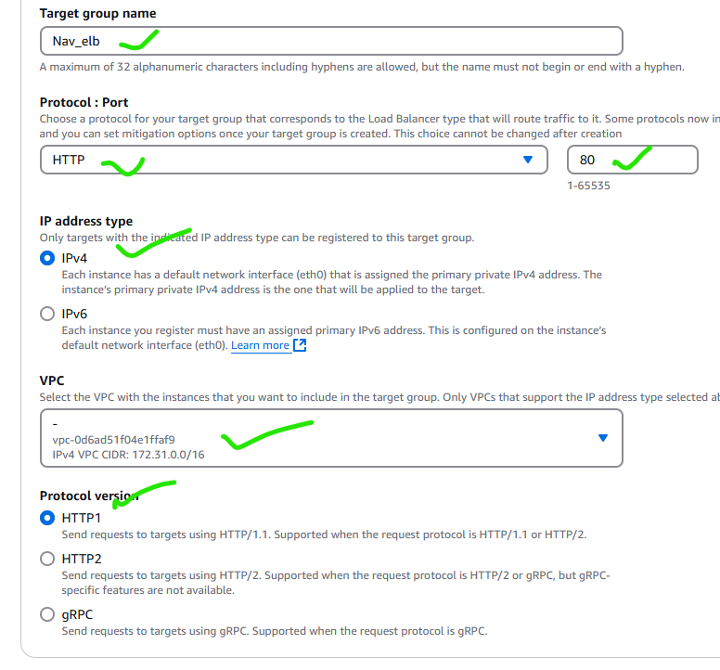
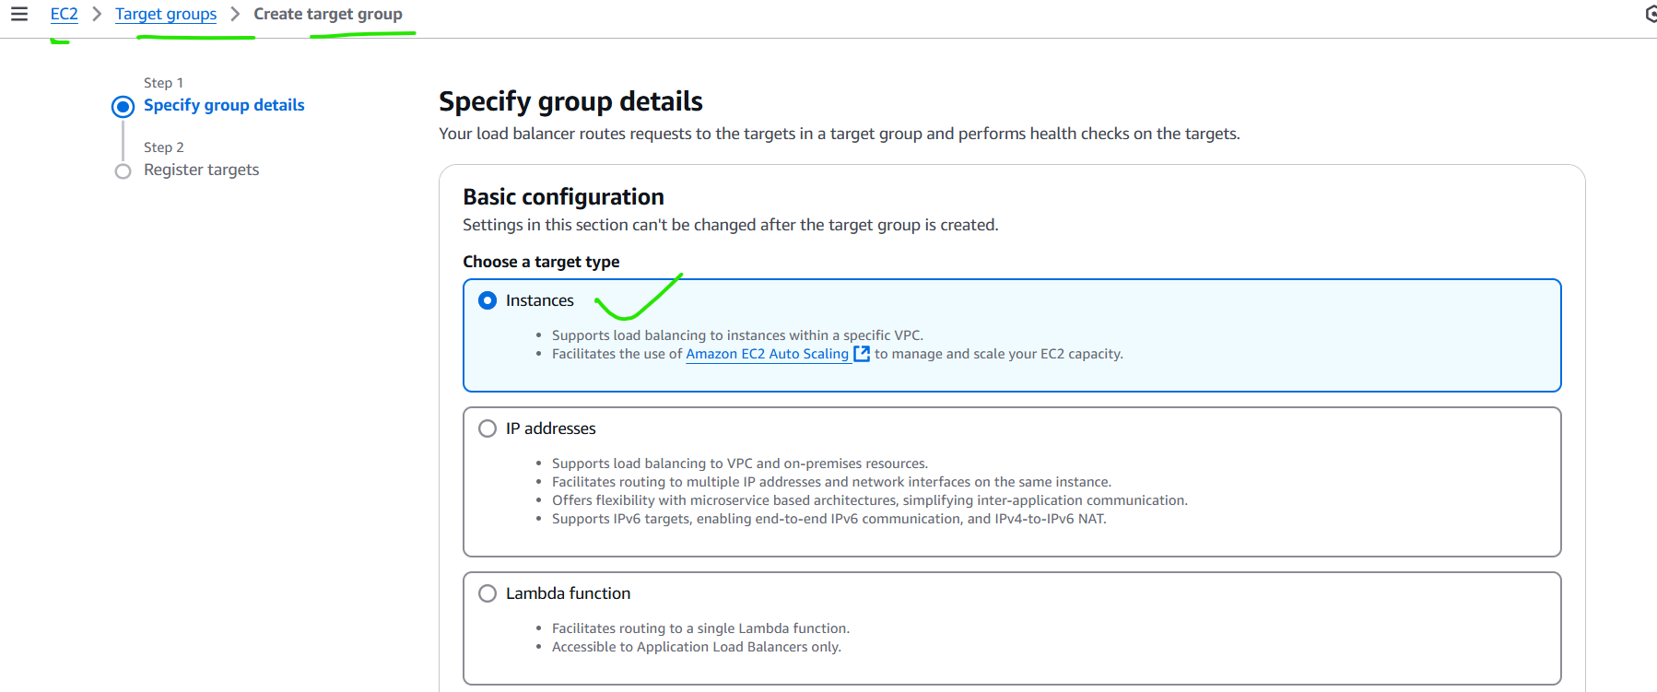
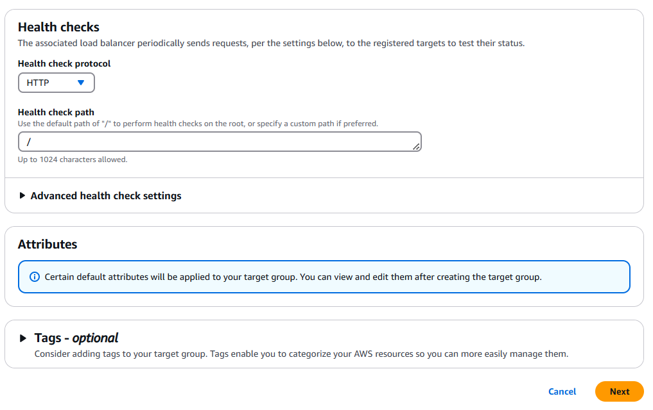
Create a Target group

Slide 7
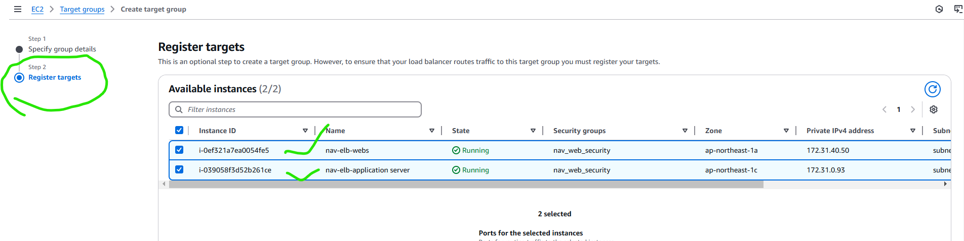
Create a Target group
Include both EC2 web and application server in Target group.

Slide 8
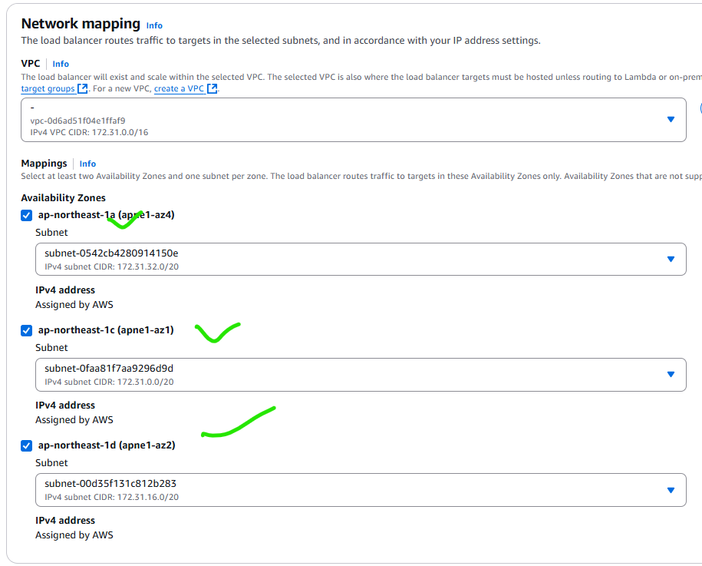
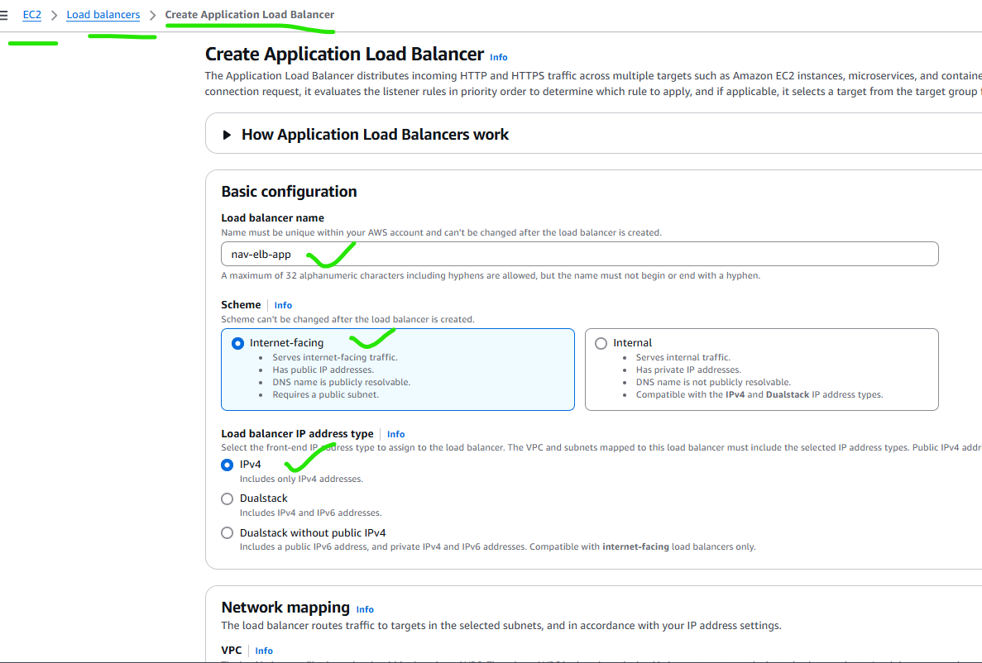
Create an Application Load balancer as below inputs

Slide 9
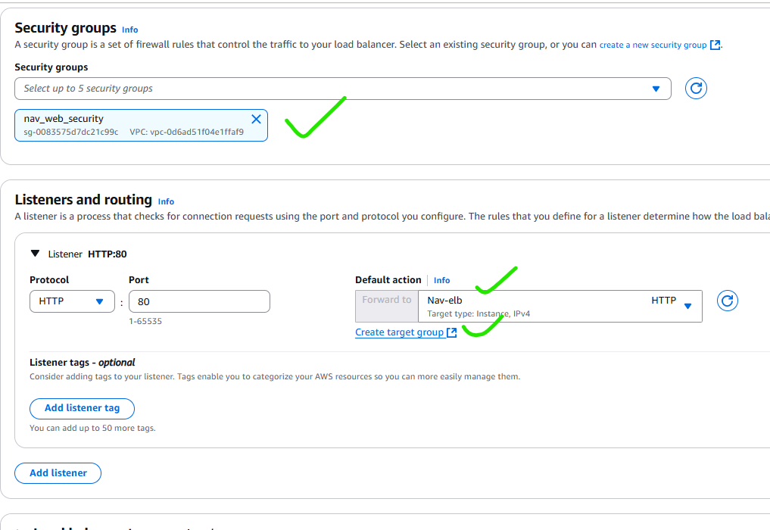
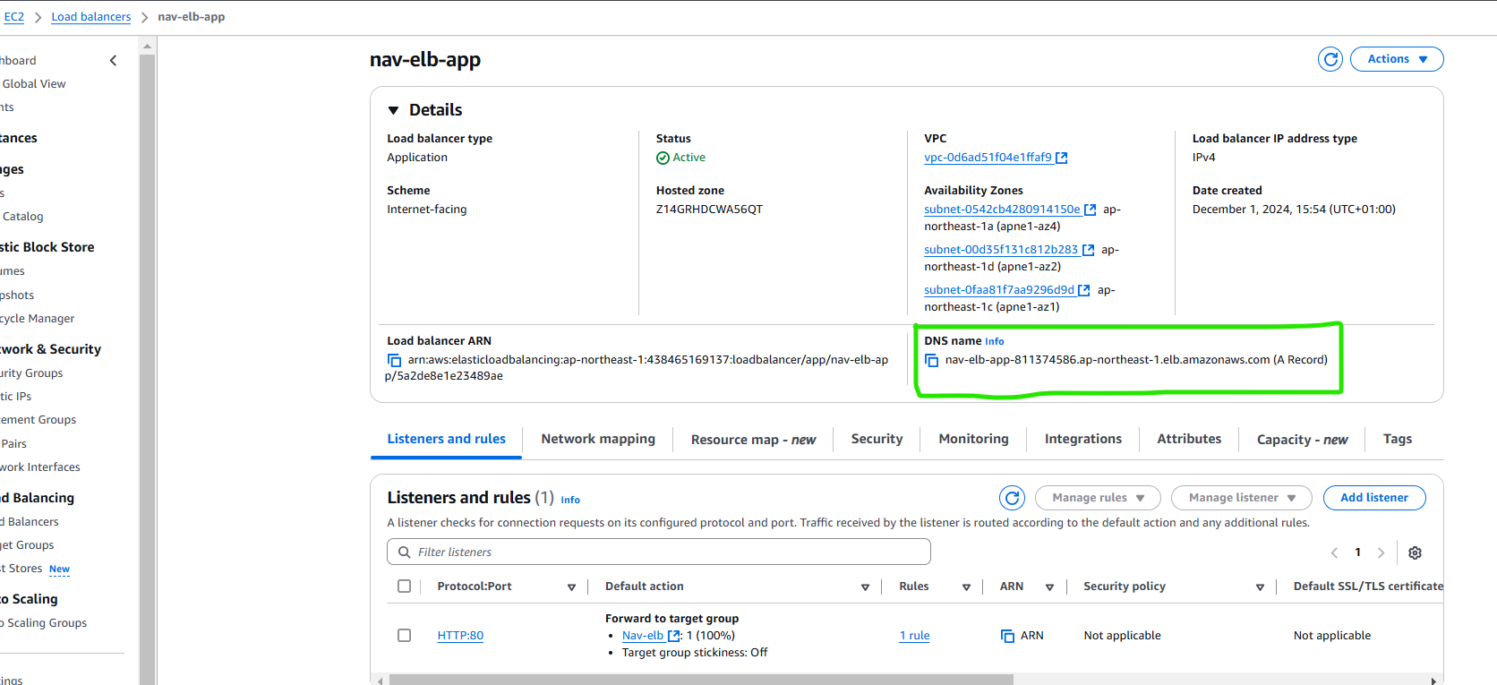


Load balancer DNS link

Slide 10
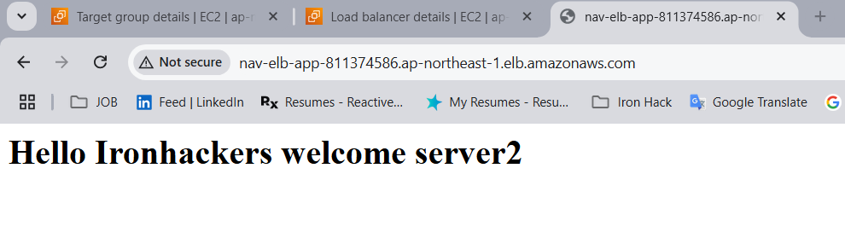
Check the ELB with DNS link and output is below

Slide 11
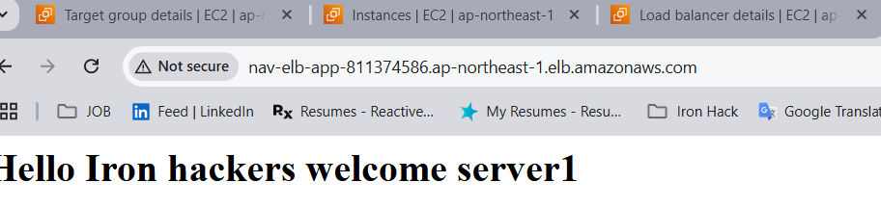
Check the ELB with DNS link and output is below when pressed again. It will divert the server when we activate it.

